Slide 1
Doctor Fee Prediction.
Team Members:
Dhaval Hanesha
Aditya Pawar
Jayesh Patil
Munazza Bhombal
Pritam Jal

Slide 2

Primary Goals:
1. Scrape all types of doctor’s data from online medical consultancy booking site Practo using python library called Beautifulsoup (or similar).
2. Scrape the dataset of Delhi, Mumbai and Bangalore for all the list of specialty doctors and create a machine learning model that can predict the consultation fee for any doctors using their key values. speciality_of_doctor , degree_type , year_of_experience ,Location ,city , dp_score , npv_
3. Create a Web page their we give these values speciality_of_doctor , degree_type , year_of_experianc ,Location ,city , dp_score , npv_ and we get their consultation fees.

Slide 3
Tech Stack:
Python Libraries :
BeautifulSoup ( For Web Scraping)
Pandas, Numpy ( For Data Manipulation and Pre-processing)
Matplotlib, Seaborn (For Visualization)
Sklearn ( For Machine Learning Models)
StreamLit :
For deployment of model which predicts the Doctor’s consultation fee.

Slide 4
Challenges faced:
With the high volume of data available on Practo, Collecting meaningful data is a big challenge using Web Scraping.
Model deployment was a big challenge faced by all the team members, as no one had any knowledge regarding building Web pages.
Time Management, as all of the team members are working professionals amd couldn’t be available for all the meetings conducted.

Slide 5
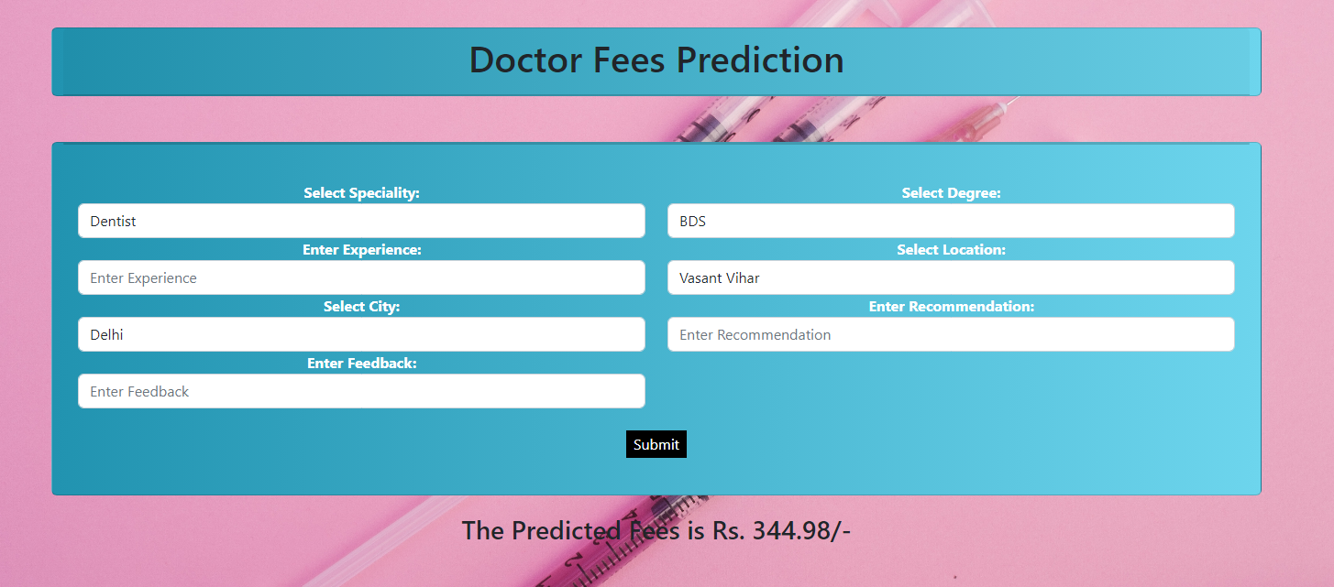
Model Deployment:

Slide 6
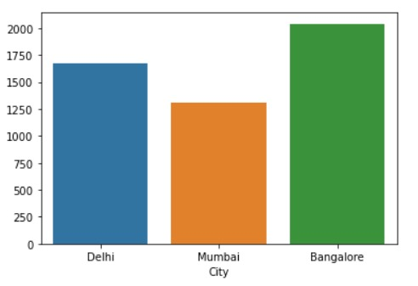
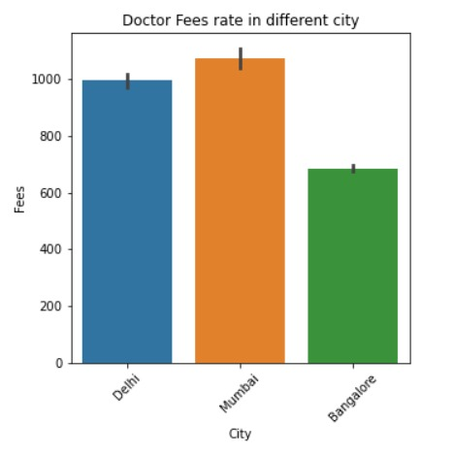
Insights:
Count of doctors with respect to different cities.
Doctor’s fee with respect to different cities.

Slide 7
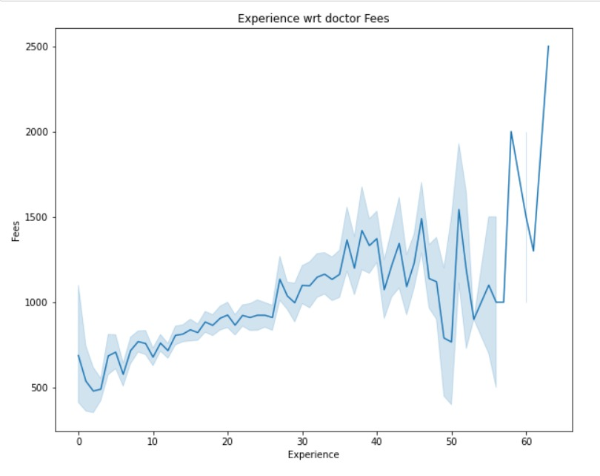
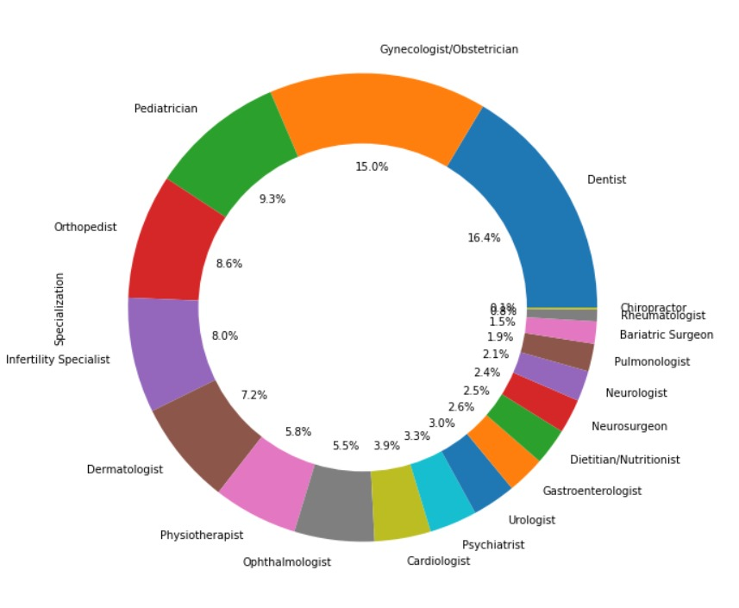
Insights:
Relationship between Doctor’s Fee and Years of Experience.
Percentage wise distribution for different specializations.

Slide 8
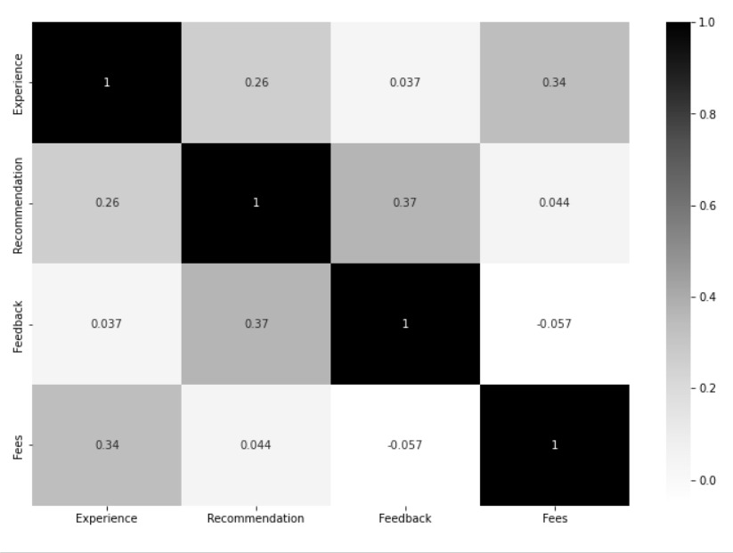
Box Plot

Slide 9
Insights:
AS THE YEARS OF EXPERIENCE INCREASES, THERE IS AN INCREASE IN THE DOCTOR’S FEE AS WELL.
The highest Count of doctors is in Bangalore Followed by Delhi and then Mumbai.
Doctor’s in Mumbai charge higher in comparison with Bangalore and Delhi.
The dataset has higher percentage of dentists, gynecologist, OBSTRETICIAN AND Pediatrician
The average fees a doctor charges is 889/-

Slide 10
Thank you!
Any Questions?

